Slide 1

Unit 9

Slide 2
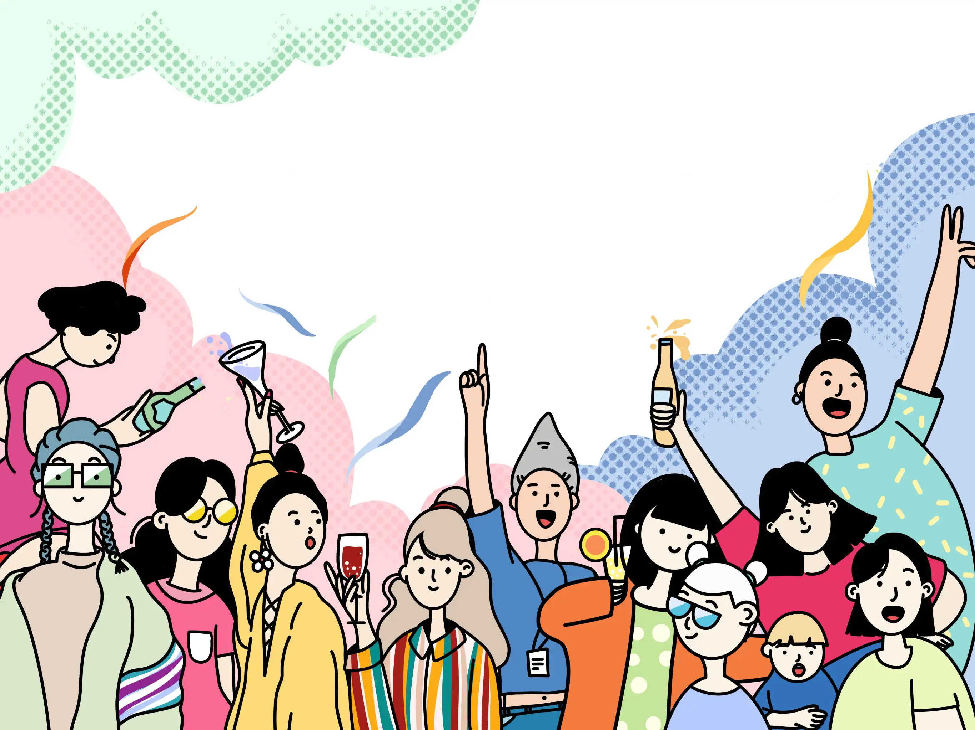
Unit 9
Can you come to my party?

Slide 3



Slide 4


1. To learn to make, accept and turn down an invitation
2. To learn the words and expressions: invitation, turn down, reply, forward, delete, print, sad, goodbye, glad, help … out, preparation, take a trip, glue, without, surprised, look forward to, hear from, housewarming

Slide 5


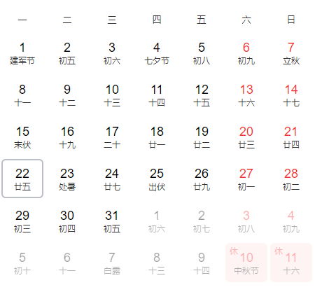
— What’s the date today/ tomorrow/the day after tomorrow?
— What was the date yesterday/ the day before yesterday…?
— It is/was …

Slide 6
— What day is (it) today/ tomorrow/the day after tomorrow?
— What day was (it) yesterday/the day before yesterday?
— It is/was …
— What’s today/tomorrow/the day after tomorrow?
— What was yesterday/the day before yesterday?
— It is/was …

Slide 7



Make a list of the kinds of parties people have.
birthday party
singing party
New Year’s party
wedding party
housewarming party
…

Slide 8
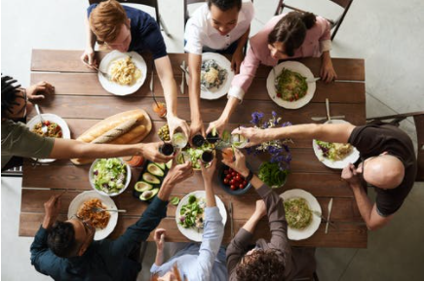

Housewarming party
乔迁派对
Costume party
化妆舞会

Slide 9
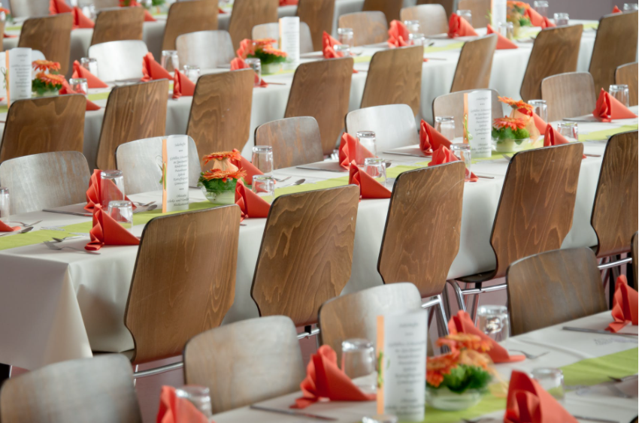
Graduation party
毕业派对

Slide 10
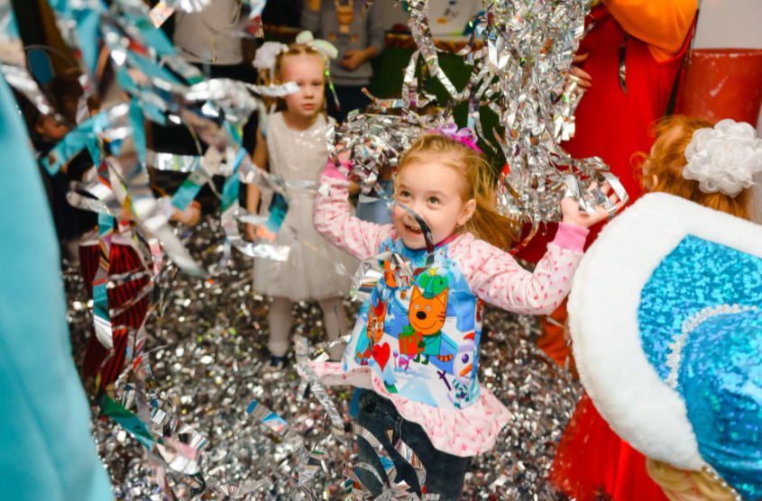
Surprise party
惊喜聚会
A surprise party is a party that is not made known beforehand (提前) to the person. Birthday surprise parties are the most common kind of surprise party.

Slide 11


If we have a party at home, what preparations do we have to make? Do you know how to make invitations?
How to accept an invitation?
How to turn down an invitation politely?

Slide 12


Read the messages quickly. Why did the people write them? Match the reason with each message.
accept an invitation
Message 1: ________________________
Message 2: ________________________
Message 3: ________________________
turn down an invitation
make an invitation

Slide 13
Find out sentences to support your answers.
Passages | Supporting sentences
Passage 1 accept the invitation
Passage 2 turn down an invitation
Passage 3 make an invitation
I can help… I can also help… I already…
I’d love to come to the party, but I’m not available.
Can you come to my party?

Slide 14
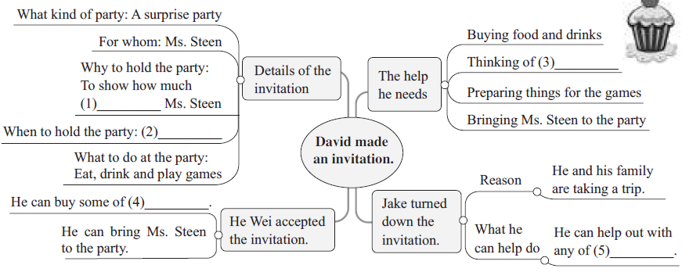
Read the messages and fill in the blanks.
they will miss / they’re going to miss
games to play
Next Friday the 28th
the food and drinks
the party preparations

Slide 15

Read the messages again and answer the questions.
1. What kind of party is it?
2. Who is the party for?
3. When is the party?
4. Who did David invite to the party?
5. What can people do at the party?
It’s a surprise party.
It’s for Ms. Steen.
It’s on Friday the 28th.
David invited his classmates to the party.
They can eat, drink and play games at the party.

Slide 16
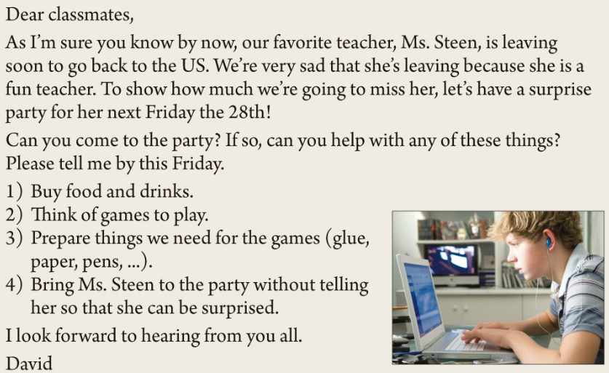
who
How to make an invitation
称呼
why
when
正文
how
落款

Slide 17
邀请函的格式
称呼
正文
落款
邀请函应具备的基本内容
人物(who)，时间(when)，地点(where)，
原因(why)，怎么样(how)等。

Slide 18
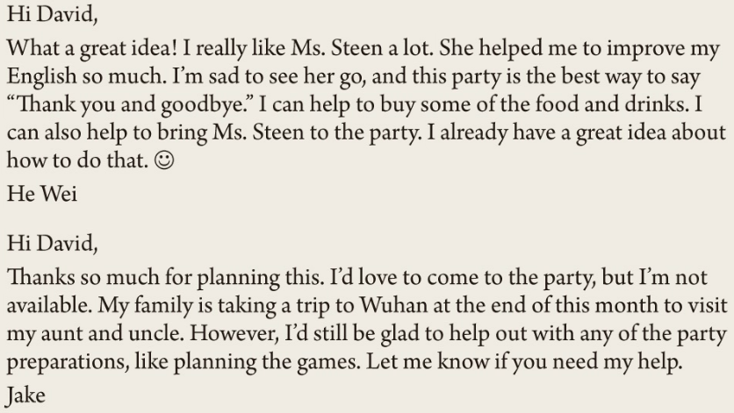
How to accept / turn down an invitation

Slide 19
Beginning:
1. Thanks so much for planning this.
inviting
2. Thank you for ________ me.
your __________.
Thanks a lot for
invitation
Ending:
1. What about another time?
2. Let me know if you need my help.
3. Thank you for inviting me.
4. Have a good time.

Slide 20

Complete the invitation with words and phrases from the messages on page 69.
We are planning a housewarming _______ at our new house this Saturday. Can you _______? Our house is at 2 London Road. We are serving ______ and ________ from 7:30 p.m. Please ________ your friends and family. A party is more _________ with more people! Please let us _________ by Wednesday ______ you can come to the party. Hope you can make it!
party
come
food
drinks
bring
fun
know
if

Slide 21



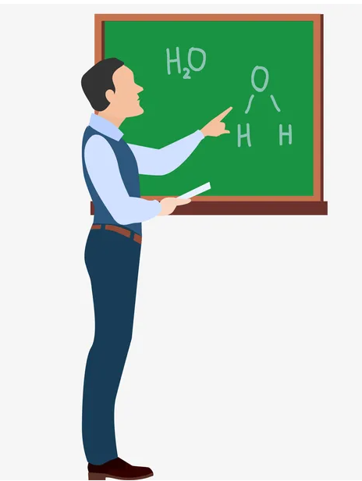

Imagine one of your favorite teachers is leaving. Plan a party for him/her. Answer the questions with a partner.
1) Why is he/she one of your favorite teachers?
2) What do you want to say to him/her?

Slide 22
3) When is the best time to have the party?
4) Where can you have the party?
5) What kind of food will there be?
6) What kind of drinks would you like to serve?
7) Who will come to the party?
8) What activities will there be at the party?
9) How can you make the party a surprise for your teacher?

Slide 23


去旅行
提高我的英语
做某事的最佳方式
(帮助……)分担工作、解决难题
到目前为止
认为；想起
take a trip
improve my English
the best way to do sth.
help out
by now
think of

Slide 24
举办一场惊喜聚会
到这周五前
盼望 / 期待做某事
接到(某人的)信、电话等
回复邀请
拒绝
have a surprise party
by this Friday
look forward to doing sth.
hear from
reply to the invitation
turn down

Slide 25


Ⅰ. 根据语境及所给首字母提示，补全所缺单词。
without
1. He drove away w saying goodbye.
2. I’m g to hear you’re feeling better.
3. I asked him what he did last night, but he didn’t r .
4. David never turns down an i to dinner.
5. I’m really s that he remembered my birthday.
glad
reply
invitation
surprised

Slide 26
Ⅱ. 根据句意，从方框中选择恰当的单词填空，注意形式变化。
daytime, delete, calendar, sad
Please _________ the first sentence (句子) because it’s
meaningless.
2. Koalas sleep in the _________ and wake up to eat at night.
3. John is _________ because his cat died yesterday.
4. According to (根据) the _________, my birthday falls on a
Sunday this year.
delete
daytime
sad
calendar

Slide 27
Ⅲ. 根据汉语意思，完成英语句子，每空一词。
1. 我很期待你下周的到访。
I’m really _______ _______ _______ your visit next week.
2. Cindy和她的朋友们上个月去马来西亚旅行了。
Cindy _______ _______ _______ to Malaysia with her friends
last month.
3. Ted叫我和他出去吃饭，但是我拒绝了他。
Ted asked me to eat out with him, but I _______ _______
_______.
4. Paul每个月都会收到他姐姐的信。
Paul _______ _______ his sister every month.
looking forward to
took a trip
turned him
down
hears from

Slide 28


Write an invitation according to 2e.

Slide 29


